Slide 1
Day 1: Docker Development

Slide 2

Get to know eachoter
Name
Tech Stack
Team/Role
About yourself

Slide 3
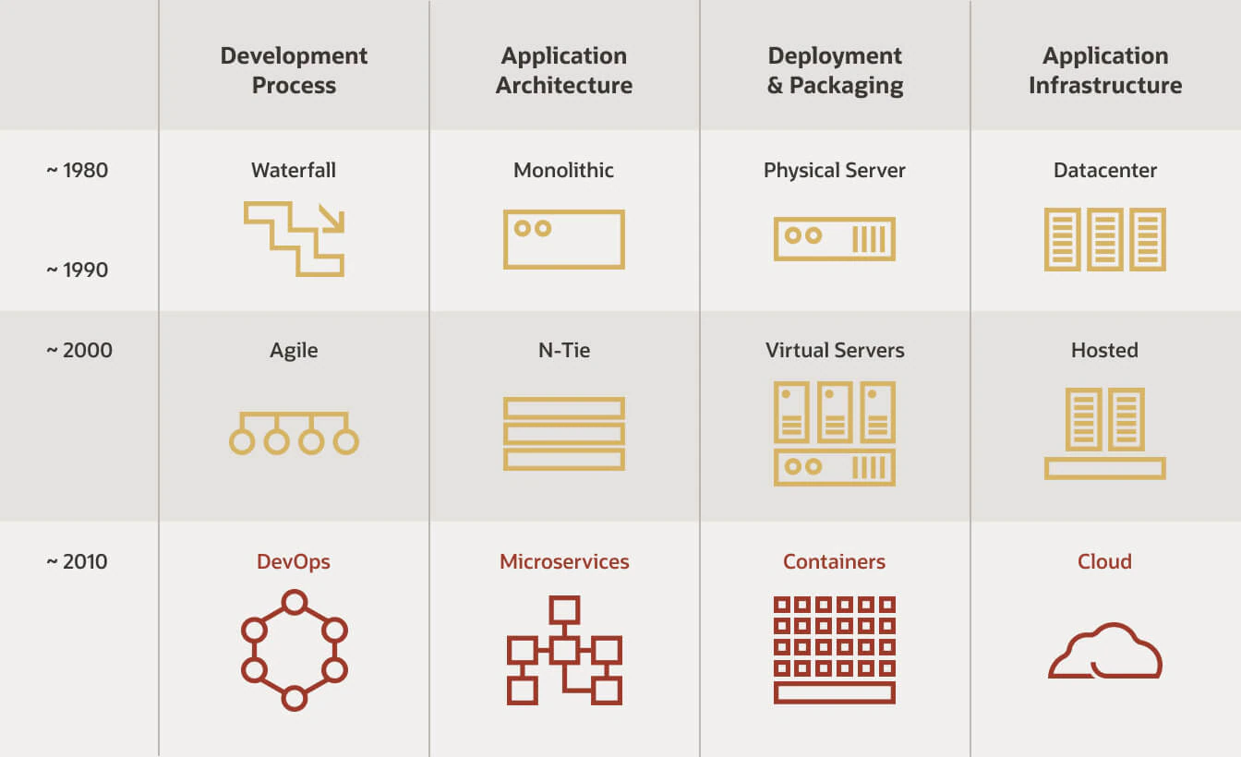
Modern software development

Slide 4
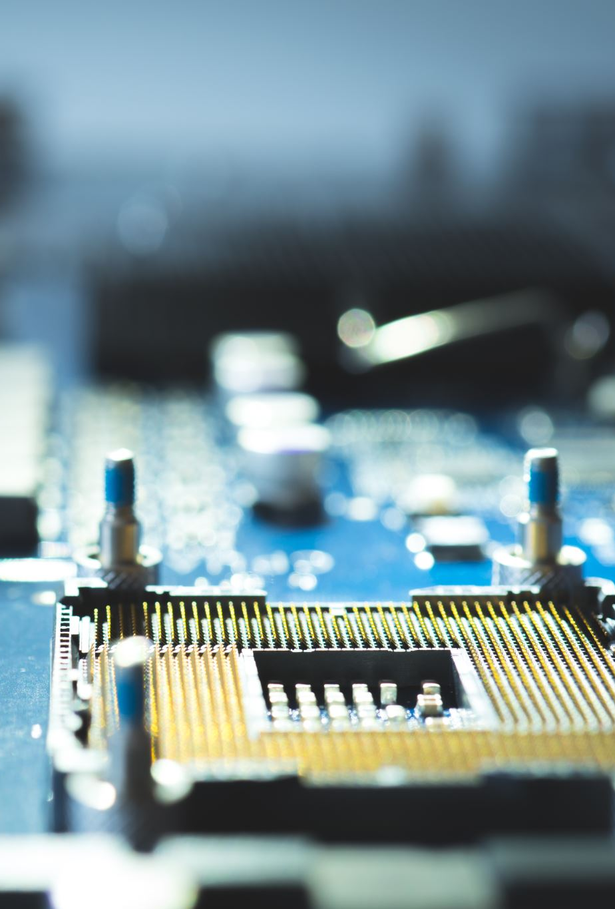
Physical Servers
A physical server refers to a hardware server with the motherboard, CPU, memory and IO-controllers. It's considered a bare-metal server because its hardware is used directly by an OS instead of a virtualization platform.
A physical server is used to run a single instance of an OS. It runs Windows, Linux or another OS and, very often, it's used to run single or multiple applications.
Apps on same machine becomes tightly coupled
Common problems are
One app needs to run another type of OS.
One app needs a specific java version to be installed
One app uses storage on the physical harddrive
It is very hard to manage physical machines for multiple apps. New hardware for each app is expensive and slow to install.

Slide 5
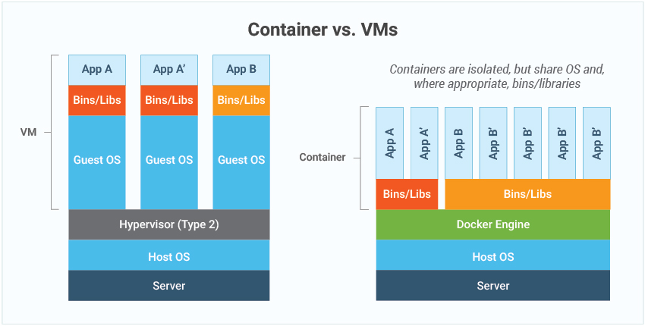

Slide 6
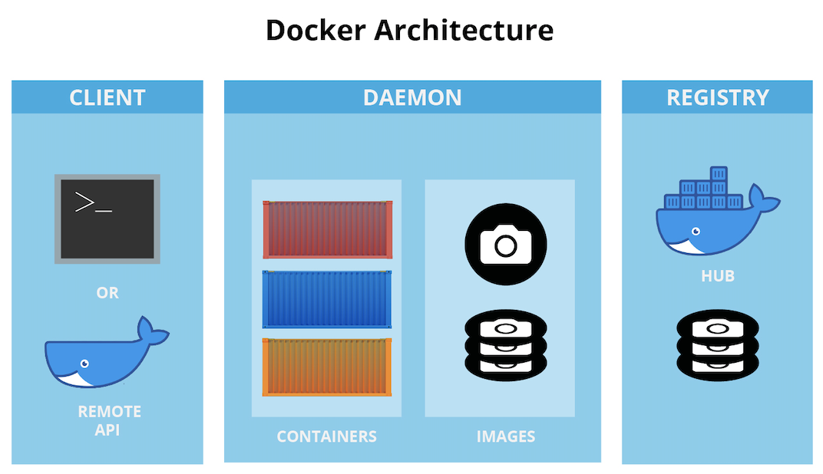
Public registry
Private Registry

Slide 7
Docker desktop is a good start
Download docker desktop: https://docs.docker.com/desktop/setup/install/windows-install/
It contains a local registry, the docker daemon and the CLI client.
We will use docker desktop as a start in this course.

Slide 8
Dockerfile Instructions:
A Dockerfile is recipe for creating images
A container is a running instance of an images
Each recipe contains a base with a snapshot of a specific os configuration.
We can modify the base by adding/removing and modifying files inside it.
Lets have a look at some basic commands:
https://dev.to/soutoigor/dockerfile-main-commands-and-instructions-2l2h

Slide 9
How is an image created?
Dockerfiles are used to create images
You need to build and tag your images and store them somewhere
Private registry
External registry
Local registry
Common workflow:
docker build -t mygimage:tag .
docker tag myimages:tag repository/myimage:tag
docker push repository/myimage:tag

Slide 10
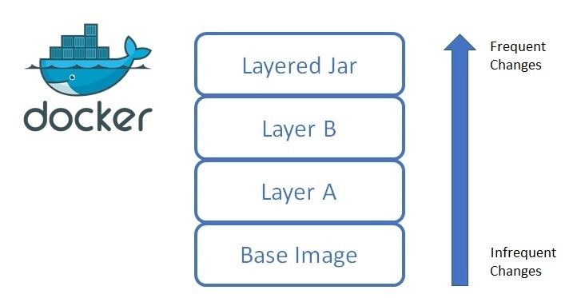
Docker is Layered

Slide 11
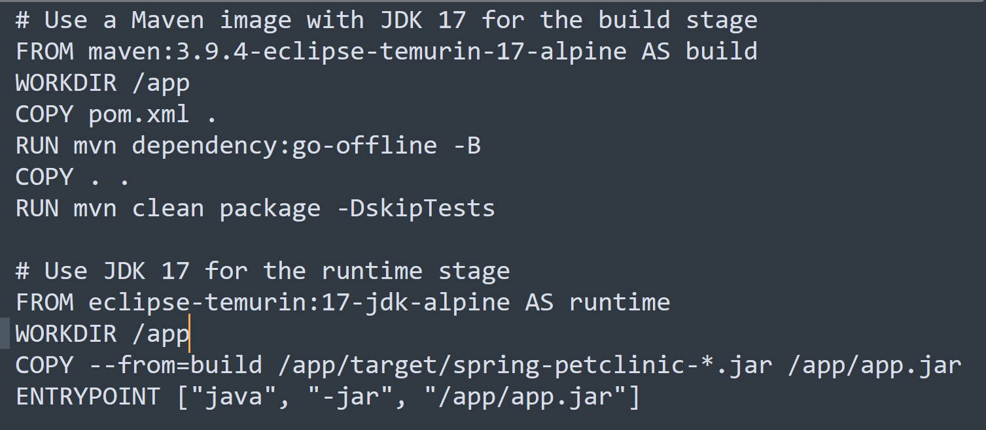
Lets look at an example

Slide 12
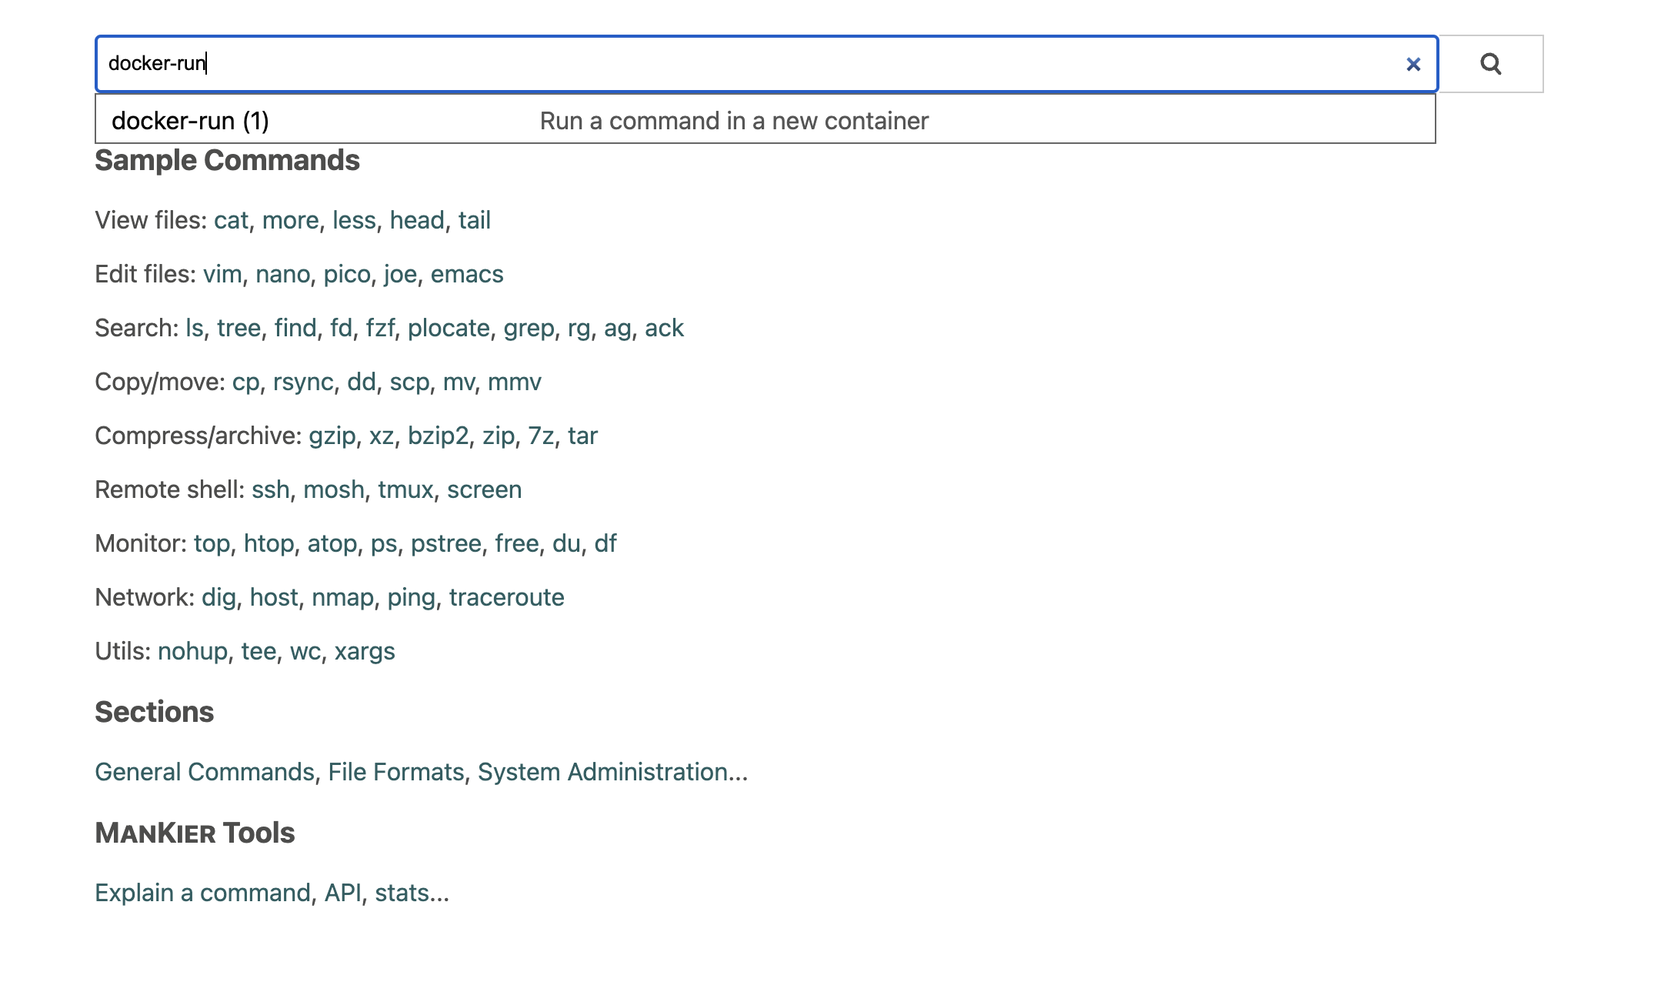
Mankier documentation
Using www.mankier.com
You can search for almost any command in linux and get examples
Documentation is translated from man pages to readable html5
You can even use it for docker, openshift and many other tools

Slide 13
Pulling docker images from dockerhub
There are multiple available public registries, default for Docker is dockerhub
An images is a snapshot of a filesystem at a given moment in time (Operating System)
When doing a docker pull, the image will end up in your local registry
We will later look at the registry hosted in Openshift
docker pull httpd:latest
You can list all images in the private (local) registry
You can see image id, tag and repository
docker images

Slide 14
Running our first container
Running the busybox container will give no result….
We can name the container so that we can easier find it
A container needs to have a process connected, or it will shutdown
docker run --name b1 httpd
Let’s connect a terminal and se what happens
Attaching a terminal (or any other process) will keep the container running
Exiting the terminal will terminate the container
docker run -it --name b2 httpd sh

Slide 15
Running a Container in detached mode
Most of the time we want to run in detached mode
When in detached mode, the container keeps running in the background.
Detached mode will make it easier to manage multiple containers.
docker run -it -d --name b3 httpd

Slide 16
Listing containers
You can list all running containers
Stopped containers will not show up
docker ps
You can list all running + non running containers
Both stopped and running containers will how up.
docker ps -a

Slide 17
Stopping and starting containers
Stopping a container
docker stop b1
running a container
docker start b2

Slide 18
Deleting containers and images
You can delete a non running container
Running containers need to be stopped before deleted
docker rm b1
You can also delete a running container
Force deleting will not terminate containers gracefully
docker rm b1 --force
You can delete images
Images will be deleted from local registry only
docker rmi busybox:latest

Slide 19
Pruning docker containers
You can delete all stopped containers with prune
docker container prune

Slide 20
Command and Entrypoint
Entrypoint: Will run automatically once the container is started, can insert arguments when starting container through commands (CMD). Entrypoint for a busybox image is ”/bin/sh”
CMD: commands can be overridden by passing new arguments.
For a busybox container you can pass an argument to the /bin/sh command
Busybox doesnt have any proccess running inside it, so it will quit automatically when started. Lets run a sleep proccess to make it stay alive.
docker run -it --name=b7 -d busybox:latest sleep 3600

Slide 21
Some more container examples
Run command in a new container from a tagged image:
docker run image:tag command
Run command in a new container in background and display its ID:
docker run -d image command
Run command in a one-off container in interactive mode and pseudo-TTY:
docker run --rm -it image command
Run command in a new container with passed environment variables:
docker run -e 'variable=value' -e variable image command
Run command in a new container with bind mounted volumes:
docker run -v /path/to/host_path:/path/to/container_path image command
Run command in a new container with published ports:
docker run -p host_port:container_port image command
Run command in a new container overwriting the entrypoint of the image:
docker run --entrypoint command image

Slide 22
How is an image created?
Dockerfiles are used to create images
You need to build and tag your images and store them somewhere
Private registry
External registry
Local registry
Common workflow:
docker build -t mygimage:tag .
docker tag myimages:tag repository/myimage:tag
docker push repository/myimage:tag

Slide 23
Dockerfile Instructions:
A Dockerfile is recipe for creating images
A container is a running instance of an images
Each recipe contains a base with a snapshot of a specific os configuration.
We can modify the base by adding/removing and modifying files inside it.
Lets have a look at some basic commands:
https://dev.to/soutoigor/dockerfile-main-commands-and-instructions-2l2h

Slide 24
Using mankier
Lets see if we can use our knowledge in docker to spin up a container in kubernetes through command line.
Search mankier for kubectl-run and see the example to create a pod.
Did our knowlede in docker help us understand kubernetes?

Slide 25
Petclinic example
Lets use spring boot petclinic to experiment with docker!
We can run the dockerfile to produce an image locally
But wait the database is missing….we need to build that too, we can reuse that image from dockerhub, but we dont have a dockerfile locally?
We know that we can pull images from a registry so lets pull it down and se if we can start it.
Now the app and database belongs together, we can use something called docker compose to start both services together as a unit.
We can put everything that belongs to our app in a file docker-compose.yaml to run containers in a more declarative way.

Slide 26
Using mankier
Lets see if we can use our knowledge in docker to spin up a container in kubernetes through command line.
Search mankier for kubectl-run and see the example to create a pod.
Did our knowlede in docker help us understand kubernetes?

